Slide 1
Introduction to Crypto
1
Price Discovery and Market Places
Kathryn Zhao
Denis Imaev

Slide 2
Introduction to Crypto
Price Formation (Price discovery)
What is the right (fair) price for an asset?
Price at which buyers and sellers agree to trade
Where and how buyers and sellers meet each other?

Slide 3
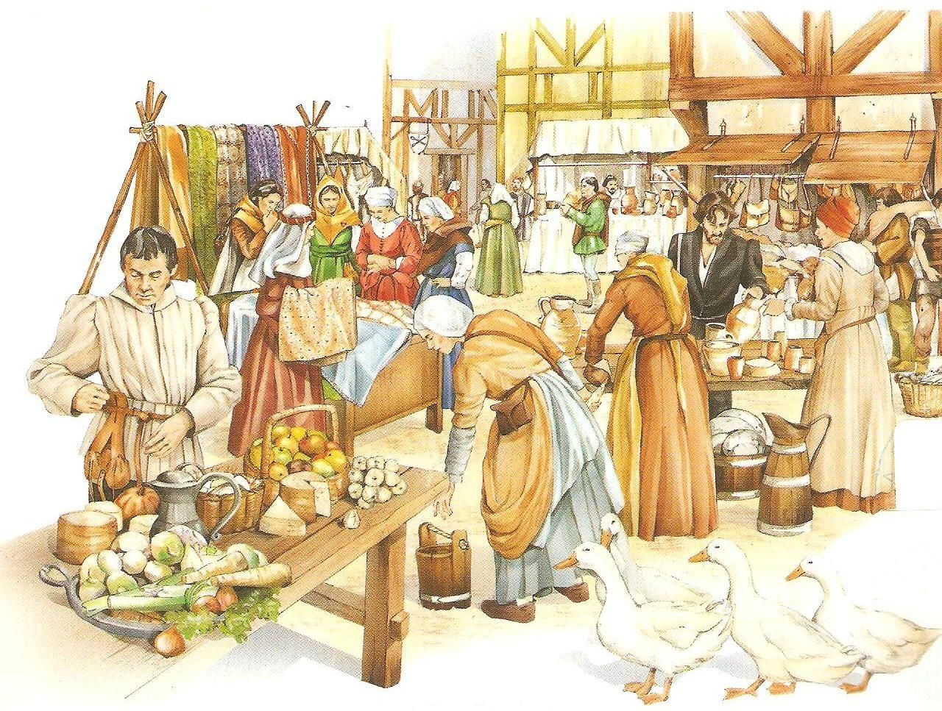
Introduction to Crypto

Slide 4
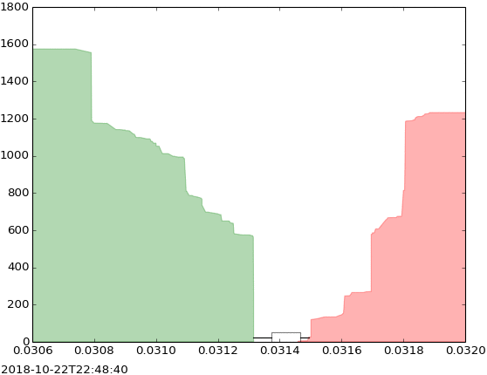
Introduction to Crypto
Price and Quantity
Fair price perception differs based on individual circumstances
Buyers/Sellers change, circumstances change → price changes
Price matters only together with quantity that is offered.

Slide 5
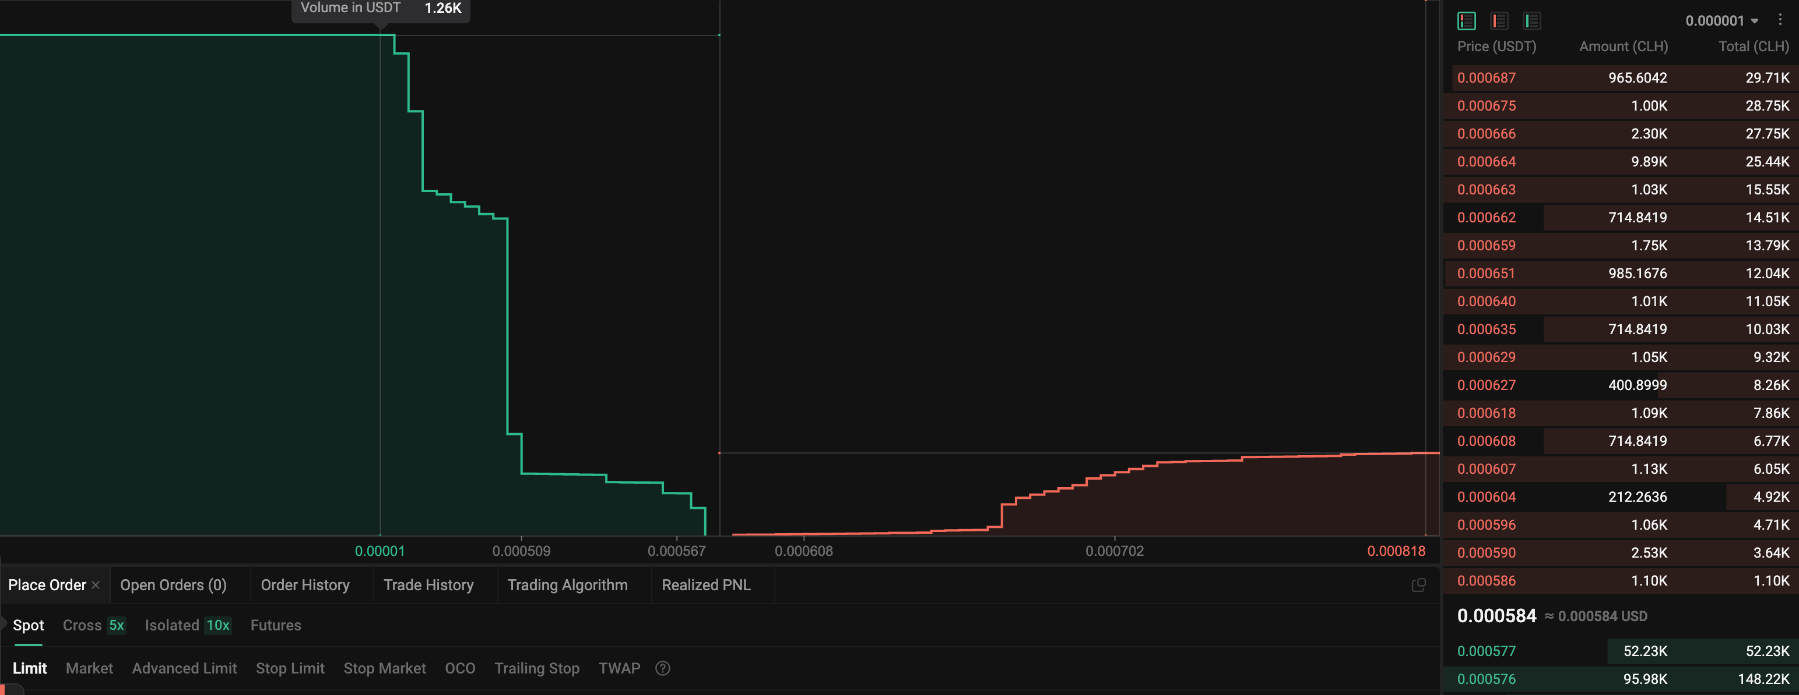
Introduction to Crypto
Price without quantity is meaningless

Slide 6
Introduction to Crypto
Slippage and Volatility
Commitment to buy/sell large quantity has more “weight”
Large orders can absorb more demand/supply, ensuring stable prices
Liquidity: aggregated quantity at different price levels
If liquidity is low, your trade price may differ from expected: “slippage”.
As the order matches with the opposite side orders, they get removed, and the next ones have worse price.
Higher liquidity → better price stability, better execution quality
Lower liquidity → high volatility (price movement)

Slide 7
Introduction to Crypto
Supply/demand interplay. Market Makers
High demand: buyers compete and bid higher prices to attract sellers.
Sellers lift the prices and wait until buyers agree and take their offers
High supply: buyers lower their prices and wait for sellers to hit their bids.
Sellers offer lower to attract buyers.
Special kind of market participants: market makers, arbitrageurs, speculator. They provide liquidity (always buy and sell).
Important service: ensures continuous liquidity.
Not a trivial feat: you can buy and sell at any time!

Slide 8
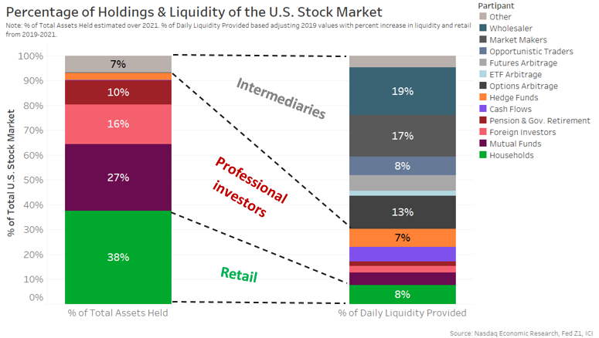
Introduction to Crypto
Market makers

Slide 9
Introduction to Crypto
Price transparency
Transparent process: everybody sees bids and offers changing
Participants derive their actions based on the current and past prices
Transactions are informed: price is fair

Slide 10
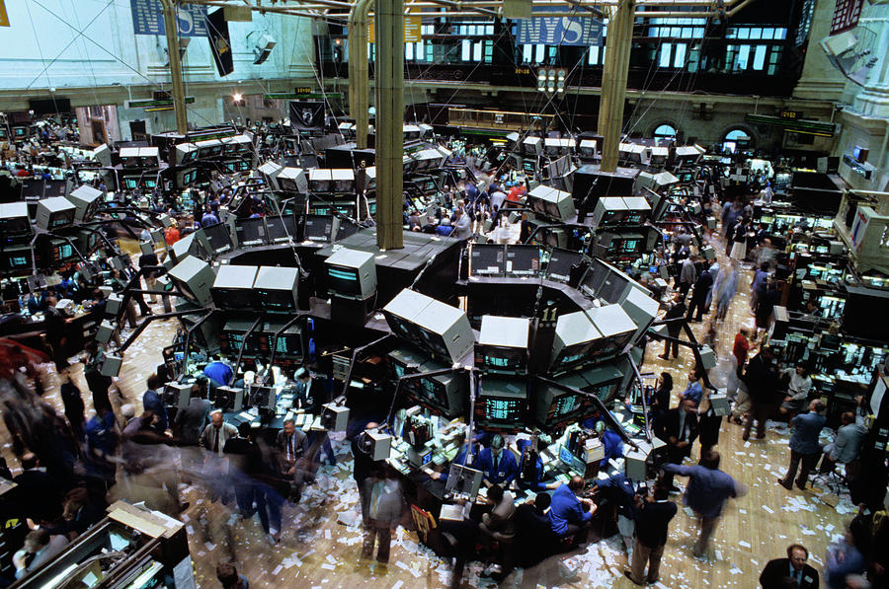
Introduction to Crypto
Centralized exchange (CEX): the traditional way

Slide 11
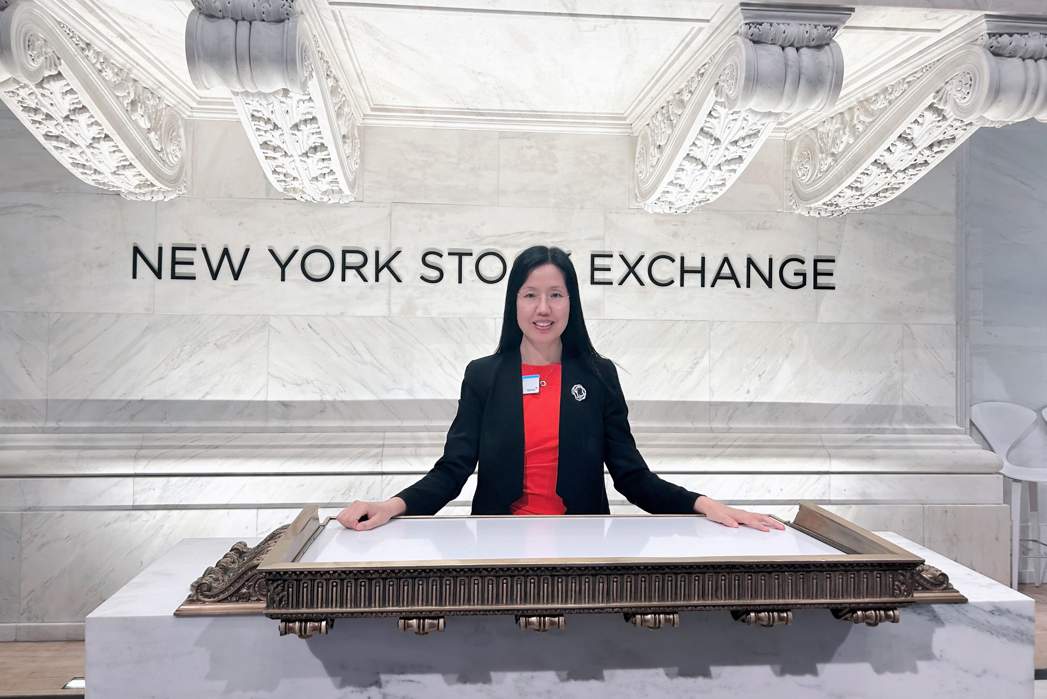
Introduction to Crypto

Slide 12
Introduction to Crypto
Order Book
Buyers and sellers place orders at marketplaces: a price/quantity pairs
Collection of standing orders form an Order Book.
Typical natural priority: price then time of entry
“Centralized“ book: the exchange maintains the books and server as intermediary
The central square of the medieval towns was the exchange.
Controlled by a concrete authority that defines rules
NYSE or Coinbase.

Slide 13
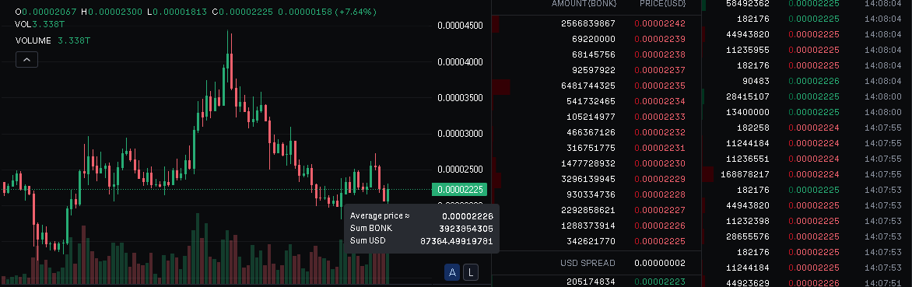
Introduction to Crypto
Order Book
Create an account on Coinbase and voila…

Slide 14
Introduction to Crypto
Order Book Statistics
Order Book Depth (1% and 5%)
Liquidity Fragmentation
Order Book Pressure
Order Book RSI
Order Book Turnover Rate
Price Impact/Slippage

Slide 15
Introduction to Crypto
Trade Book Statistics
Total Traded Volume
Net Trading Pressure
Trade Count
Bid-Ask Spread and Volatility
Liquidity-Weighted Price vs. Volume-Weighted Price

Slide 16
Introduction to Crypto
CEX Advantages
Speed
Central authority is a guarantor of rules
Mediating “disputes”, protecting against nefarious actors
Vital for both institutional and retail: managed counterparty risk
Especially retail need “protection”
Simplicity of use, historically natural price discovery
Enforced Know-Your-Customer

Slide 17
Introduction to Crypto
CEX Disadvantages
Central point of failure
Lack of transparency in how the central authority operates
Security risks: loss of client data, funds
Technical failures and hacks too: Mt Gox
Trader money is locked in the exchange custody.
Clients lose control of their funds that can be lost (ex. bankruptcy)
The central authority keeps the clients’ funds in its own wallet.

Slide 18
Introduction to Crypto
Decentralized exchanges (DEX)
Not your keys - not your money
Decentralize everything
Decentralized Exchange: marketplace in which trading activities are blockchain transactions
The exchange is a smart contract
Orders are transactions sent to the exchange’s contract.
.
No central authority.
Rules are code
.

Slide 19
Introduction to Crypto
Decentralized exchanges (DEX)
Address 1
Address 2
DEX Smart Contract:
Tx3: transfer 0.5 BTC to address 1, transfer USDT worth of 0.5 BTC to address 2
Tx1: BUY 1 BTC/USDT @0.1
Tx2: SELL 0.5 BTC/USDT @0.099
Block
(…, Tx1, …)
Block
(…, Tx2, …)
Block
(…, Tx3, …)

Slide 20
Introduction to Crypto
DEX Advantages
The key feature: participants interact with one another on a peer-to-peer basis.
No intermediary and no entry barriers: market access for all
Fewer parties interacting - less risk
Safety and security of the blockchain
Anonymous
Lower fees (theoretically…)

Slide 21
Introduction to Crypto
DEX disadvantages
Lower speed: blockchain transactions are (still, relatively) slow
Easier arbitrage: takes time for price information to propagate between different marketplaces
Low liquidity levels (less popular for now) → lower price stability, high volatility
Unpredictable fees, dependent on the network load
Things that are nothing to do with trading
Intrinsic front-running opportunities…

Slide 22
Introduction to Crypto
DEX disadvantages: bugs and scams
Can a “black swan” event like high volatility break it?
Complex code means that code bugs can be exploited.
Each blockchain feature is a potential vector of attack.
SCAM alert!
If you get scammed out of your coins - there’s no one there to save you and compensate you.
This is not a “killer” argument against DeFi but needs to be addressed before DeFi can fulfill its true promise.

Slide 23
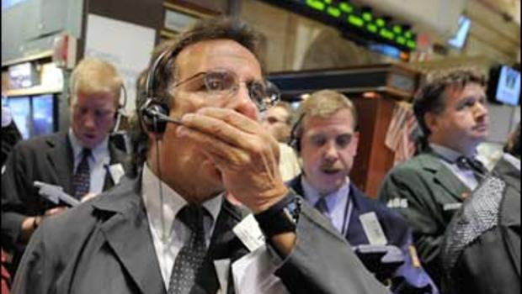
Introduction to Crypto
This guy still does a lot for you!
He is there to absorb your losses and manage YOUR counterparty risk !

Slide 24
Introduction to Crypto
DEX: order priority
Classic Order Book: orders have well defined priority based on price and time of arrival
Orders are not visible until they are part of the book
DEX order priority: when order transactions becomes part of the chain.
That means block builders (miners) have the ultimate discretion over transaction sequence in the block
Miners decide the order of trades.
For a miner, are all transactions equal?

Slide 25
Introduction to Crypto
Maximal Extractable Value
Anyone can pay for their transaction to have a higher priority
For miners, it makes sense to process higher paying transactions first and then the rest, or even “ignore” them.
This sounds fine... Except how does it affect trading?
Miners can inject their own transactions wherever they want.
Orders are visible to all even before they “accepted” (become part of the chain)
How can anyone benefit from that?

